Slide 1
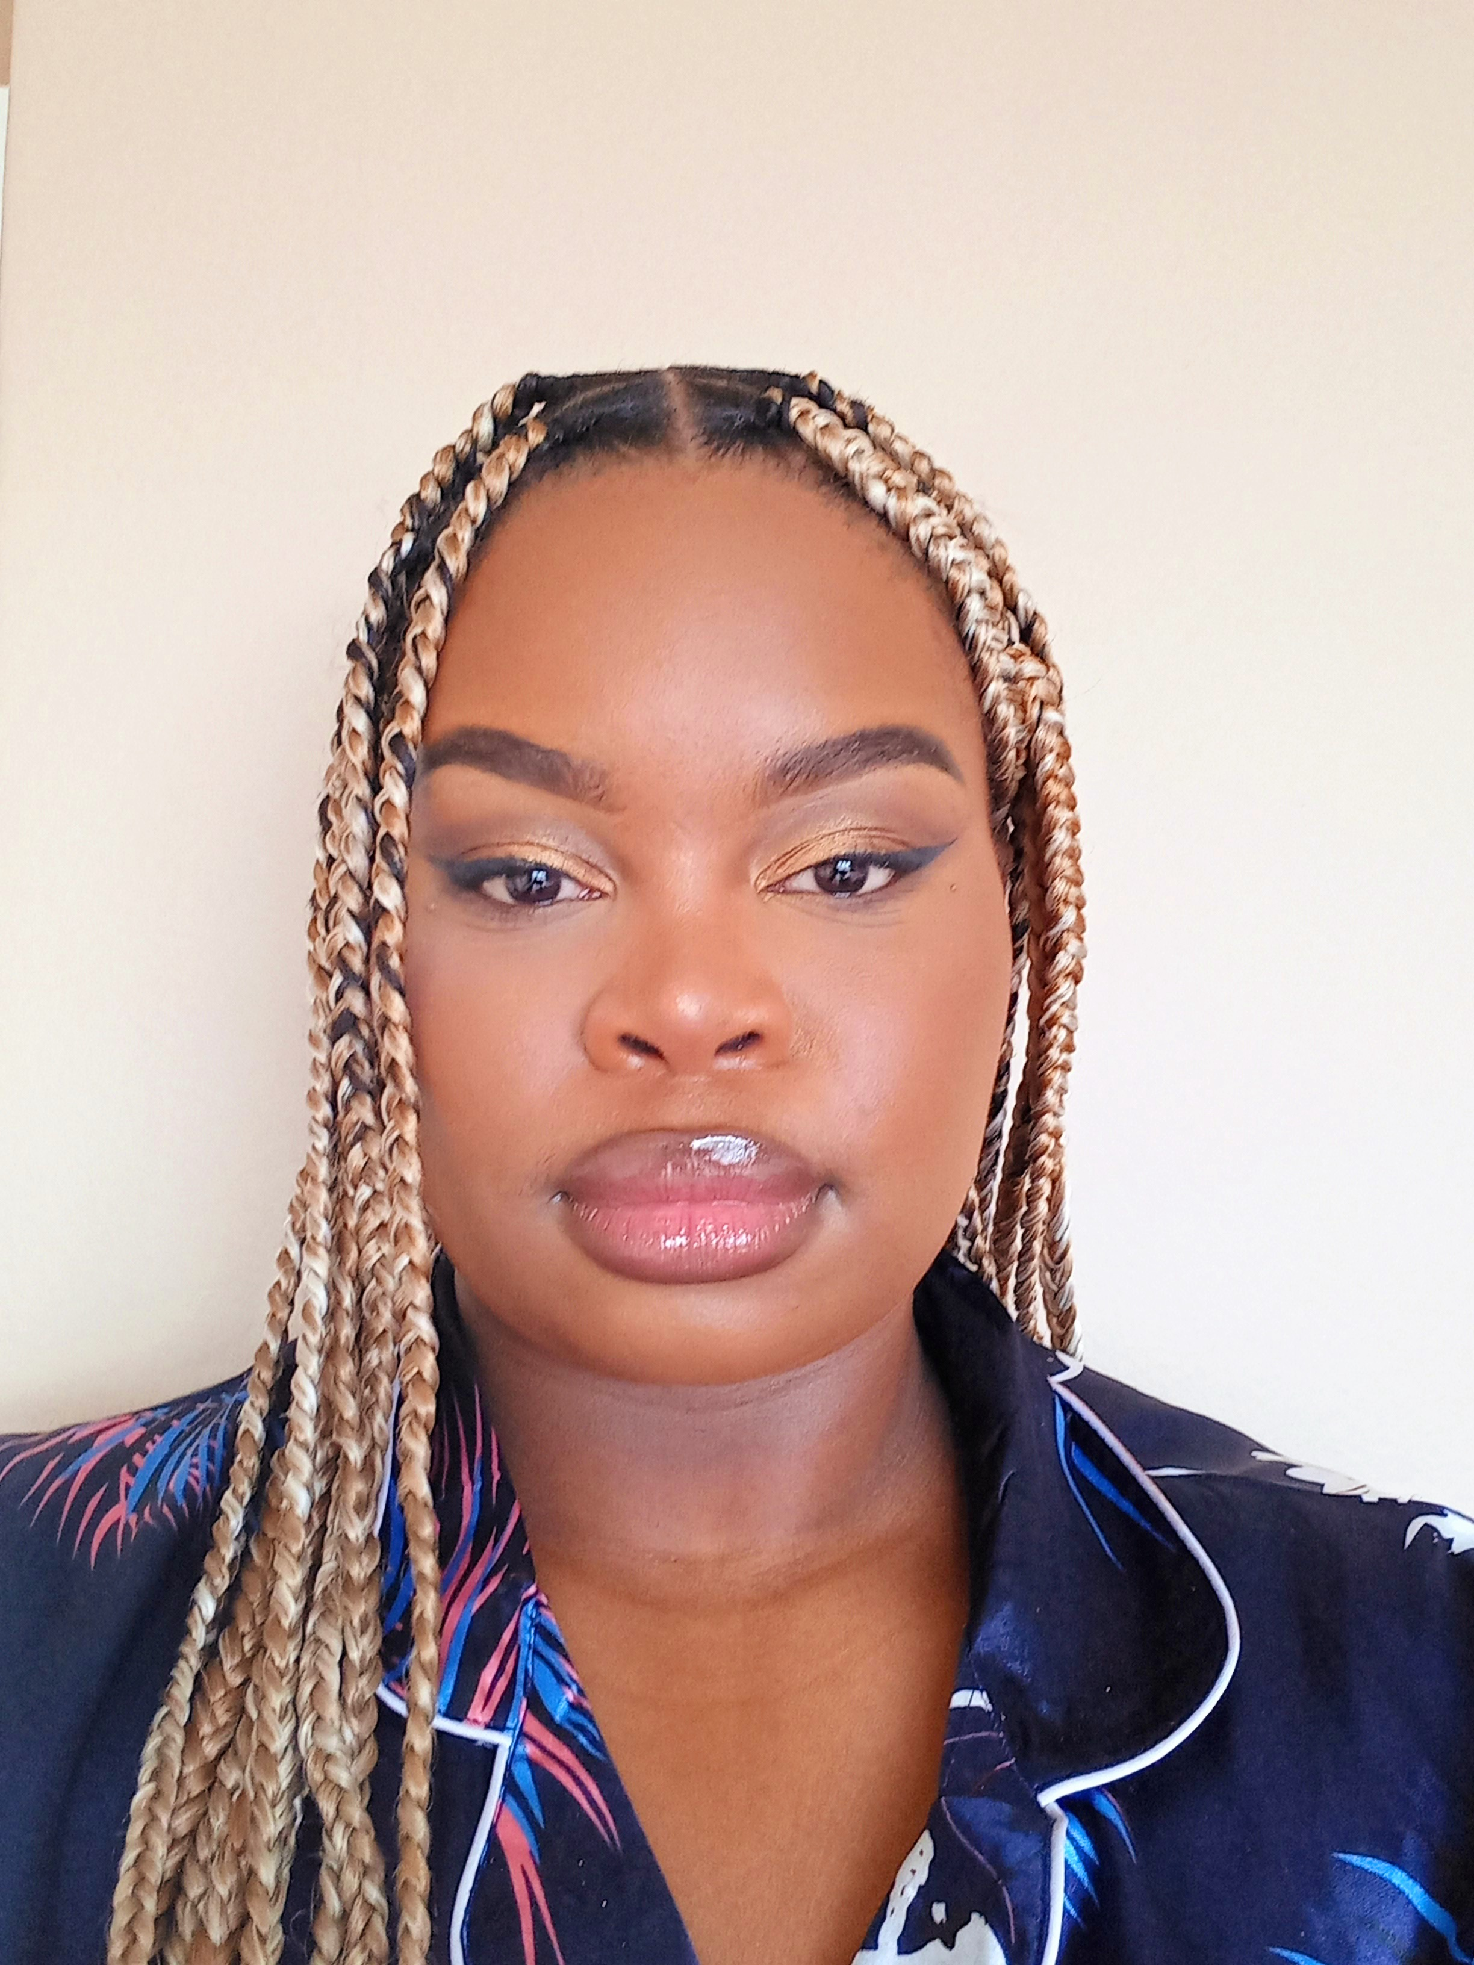
Self portrait of buhle Mthethwa
By Buhle Mthethwa
JMS3 2022

Slide 2
Audio self portrait
Intro: Buhle Mthethwa is a third year journalism student at Rhodes University who is currently working her way into the field in the hopes of making change. This is her story…
In: About 21 years ago…
Out: to great things.
Duration: 3 mins

