Slide 1
Sound Portrait
By Buhle Mthethwa

Slide 2
My Second Home: Rhodes University
Intro: When Buhle first came to Rhodes University, the transition was difficult. But over time she began to see this place as her second home. Here is her sound rich portrait of her favorite places in Rhodes and Grahamstown.
In: When I first…
Out: I’d rather be.
Duration: 3 minutes 19 seconds

Slide 3
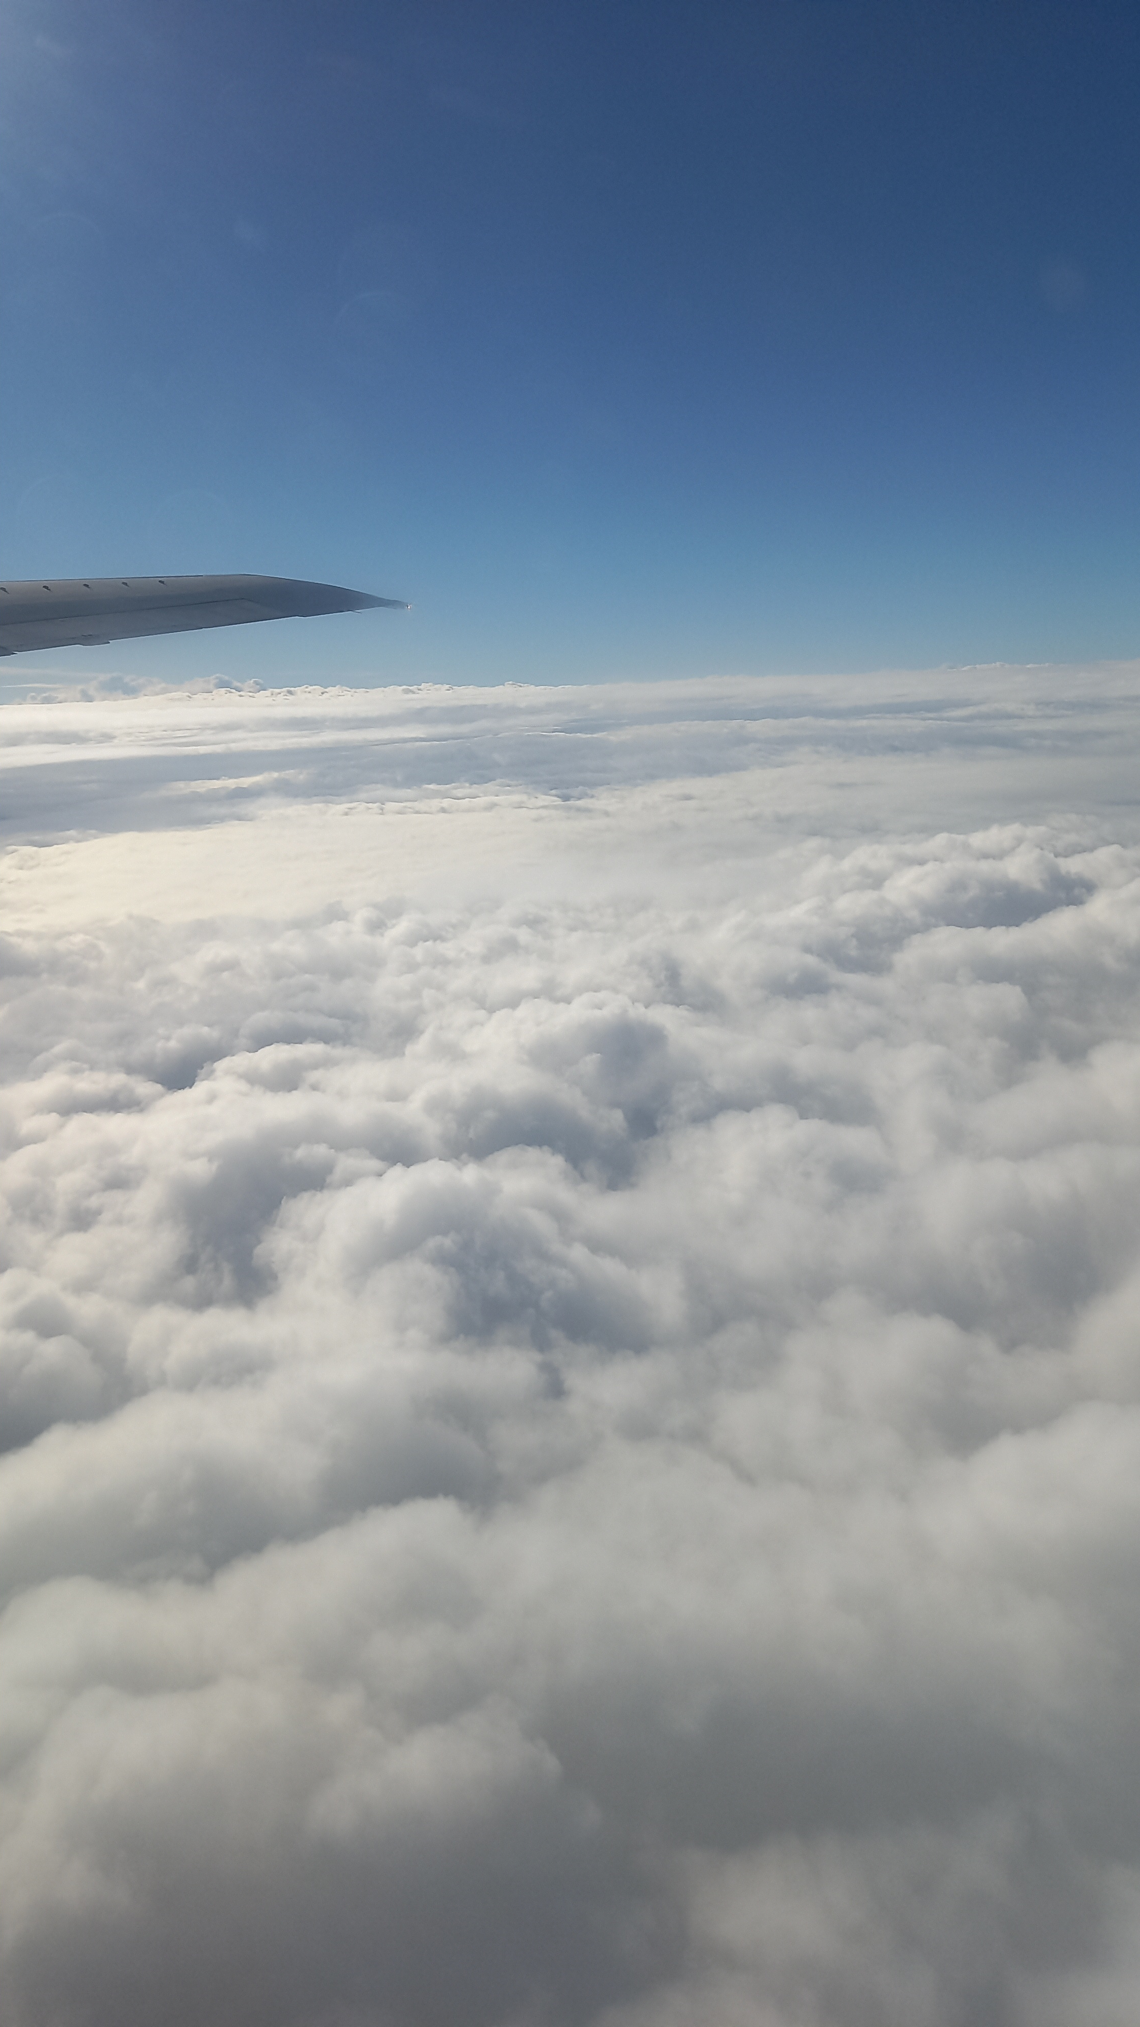
Air Journey:

Slide 4
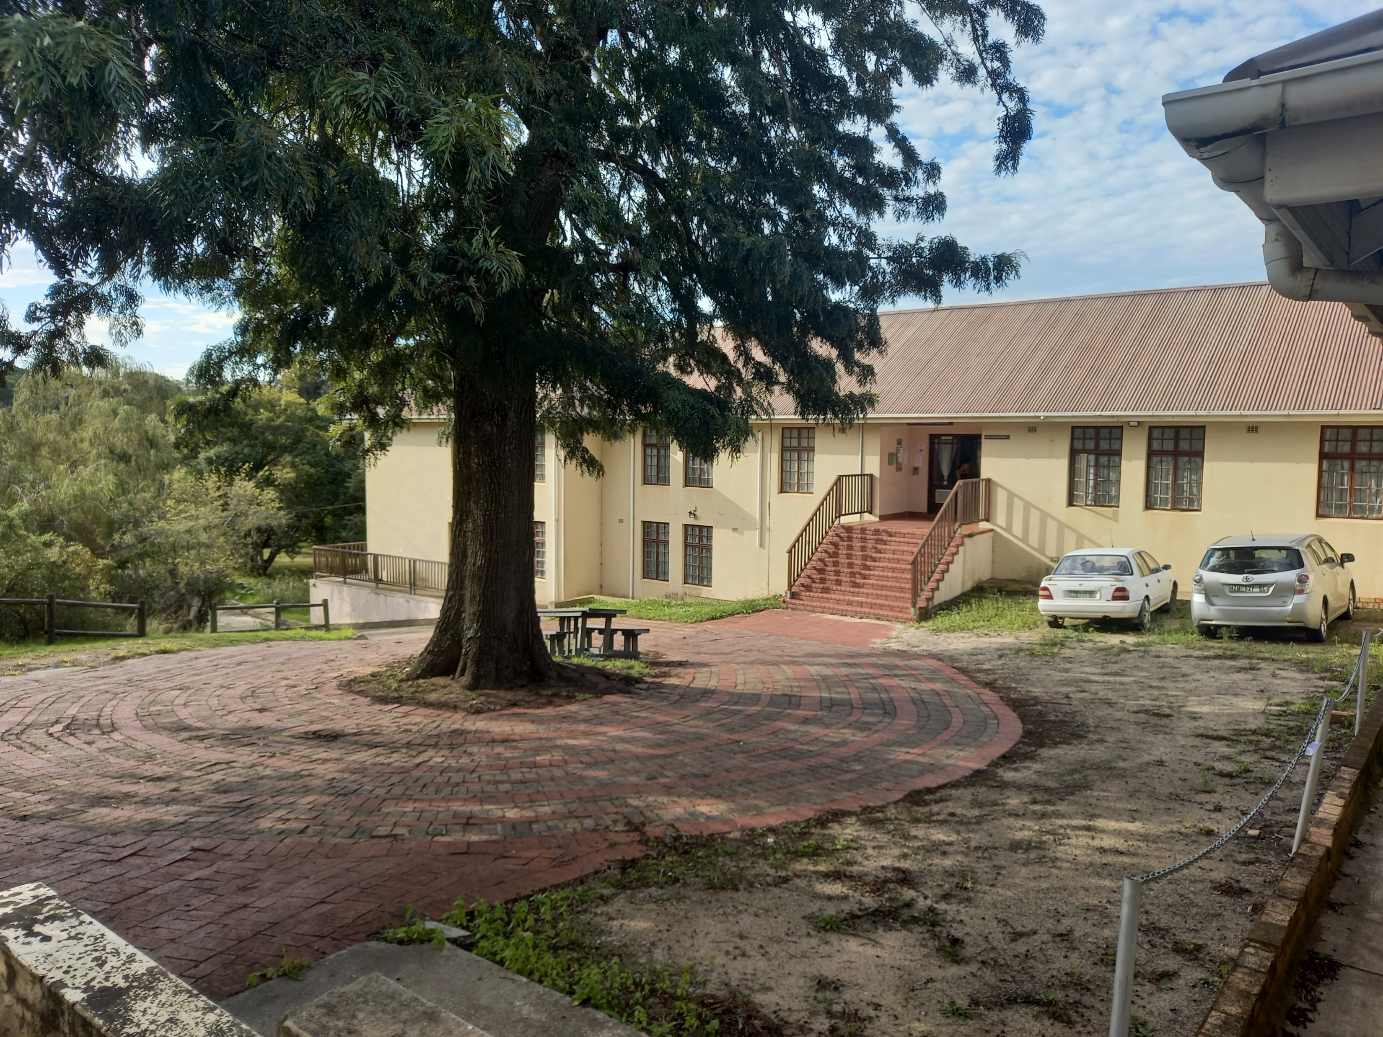
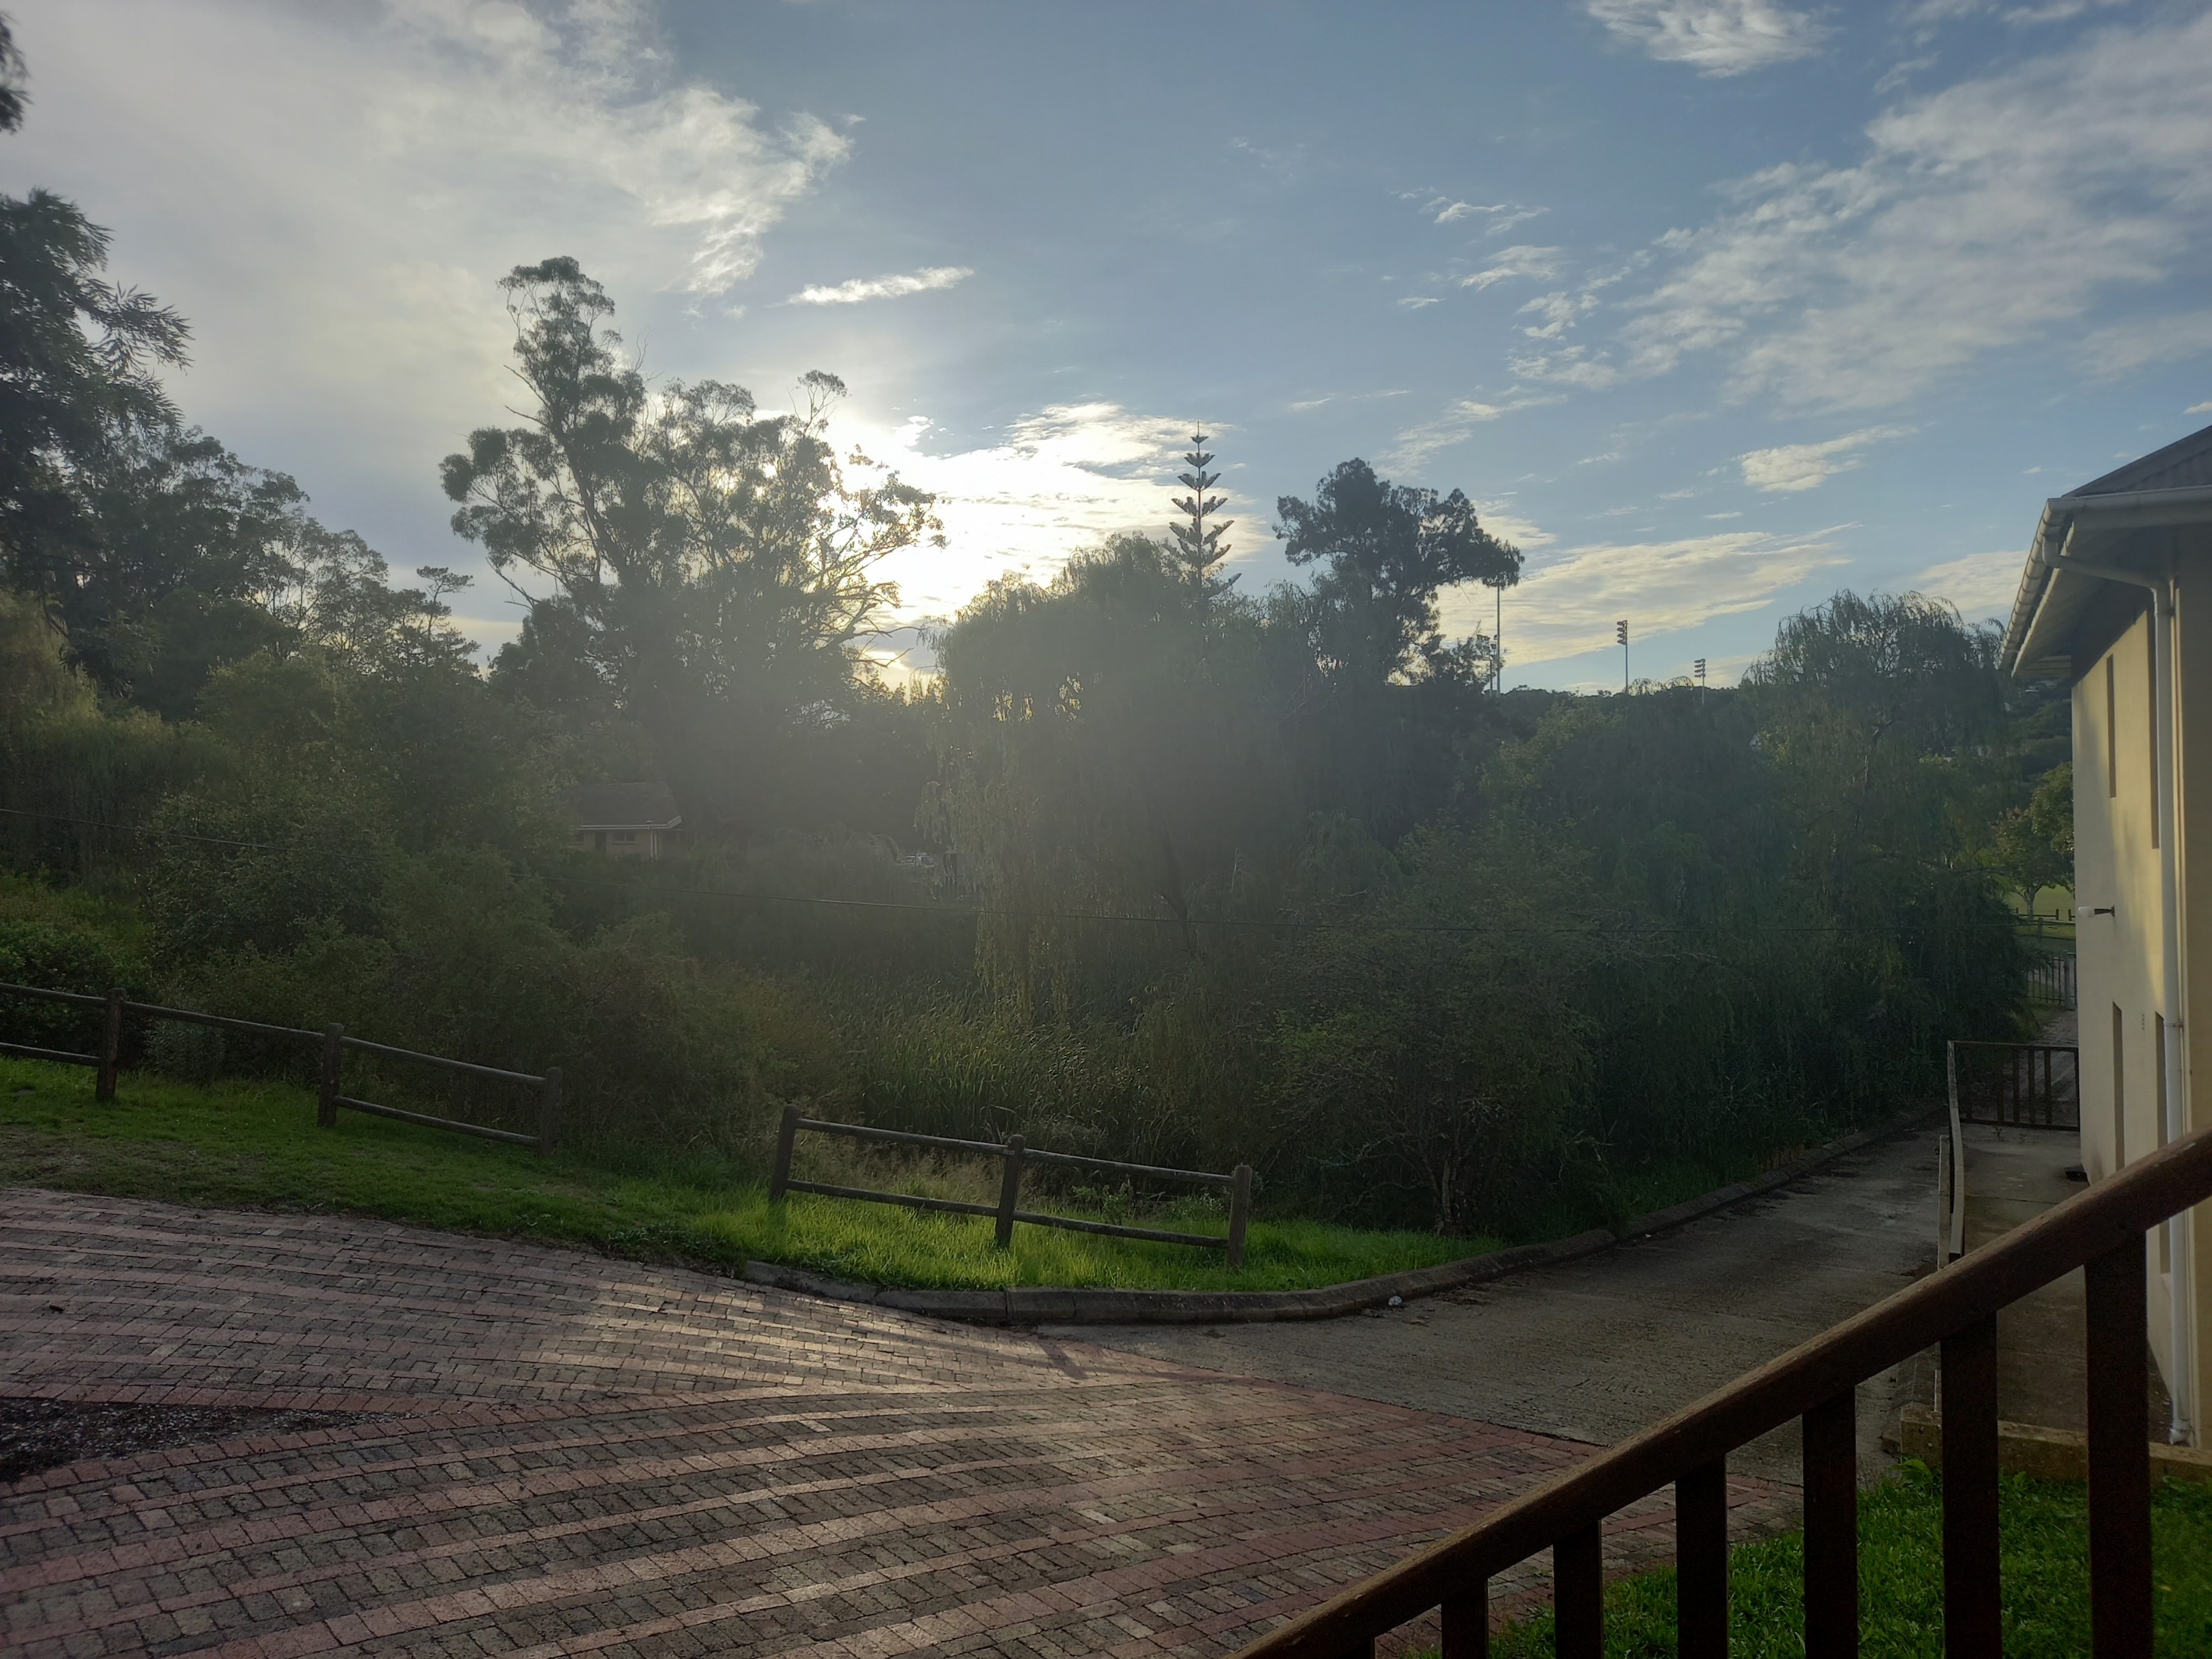
Serenity in front of Helen Joseph

Slide 5
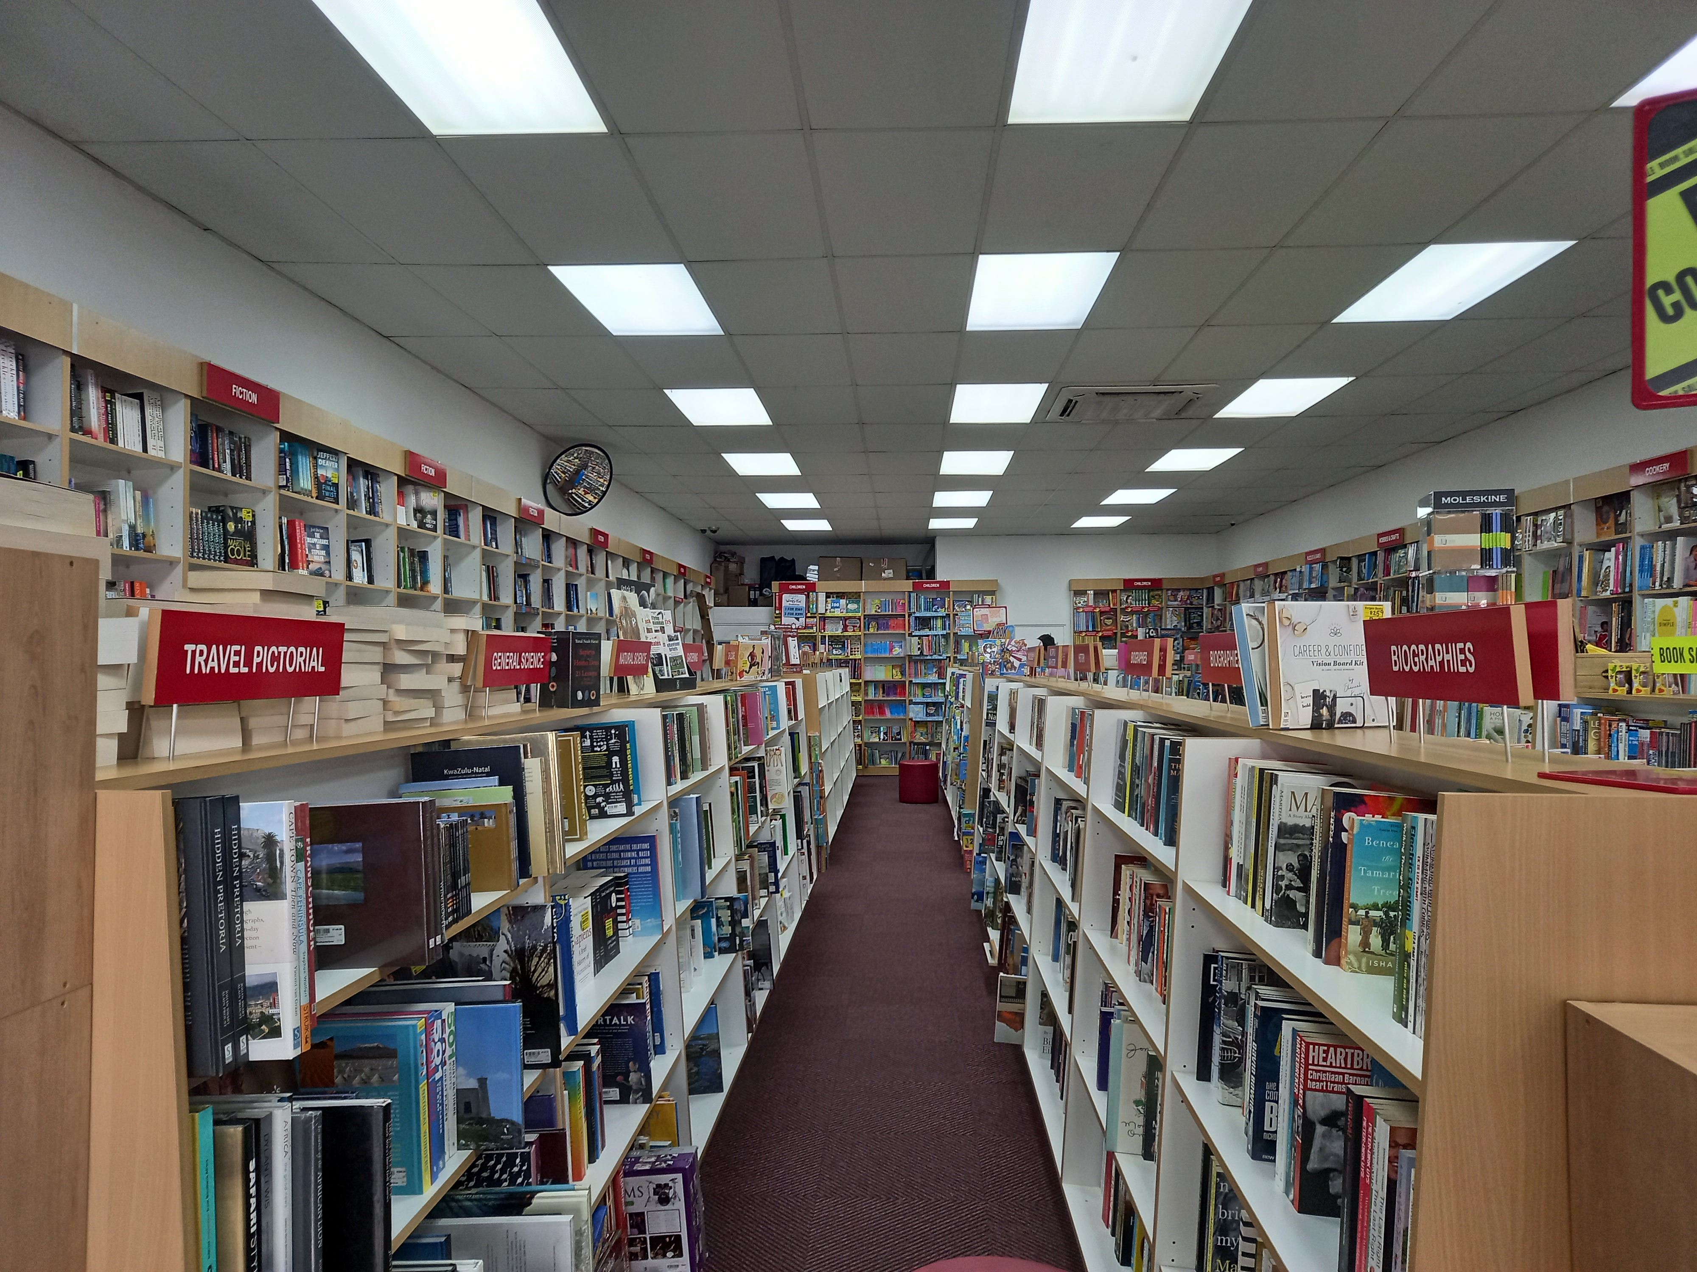
Book Store

Slide 6
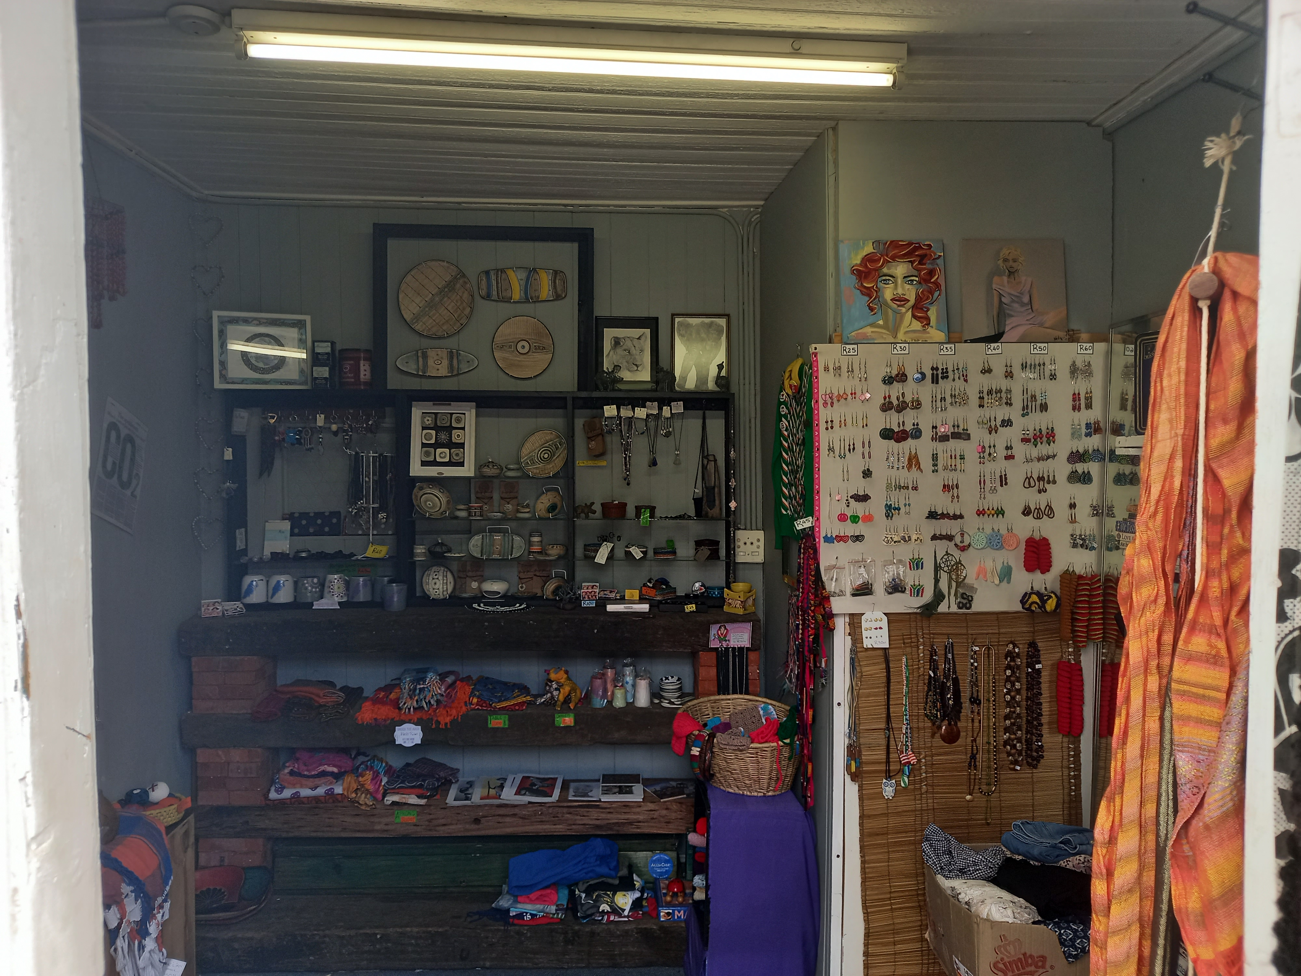
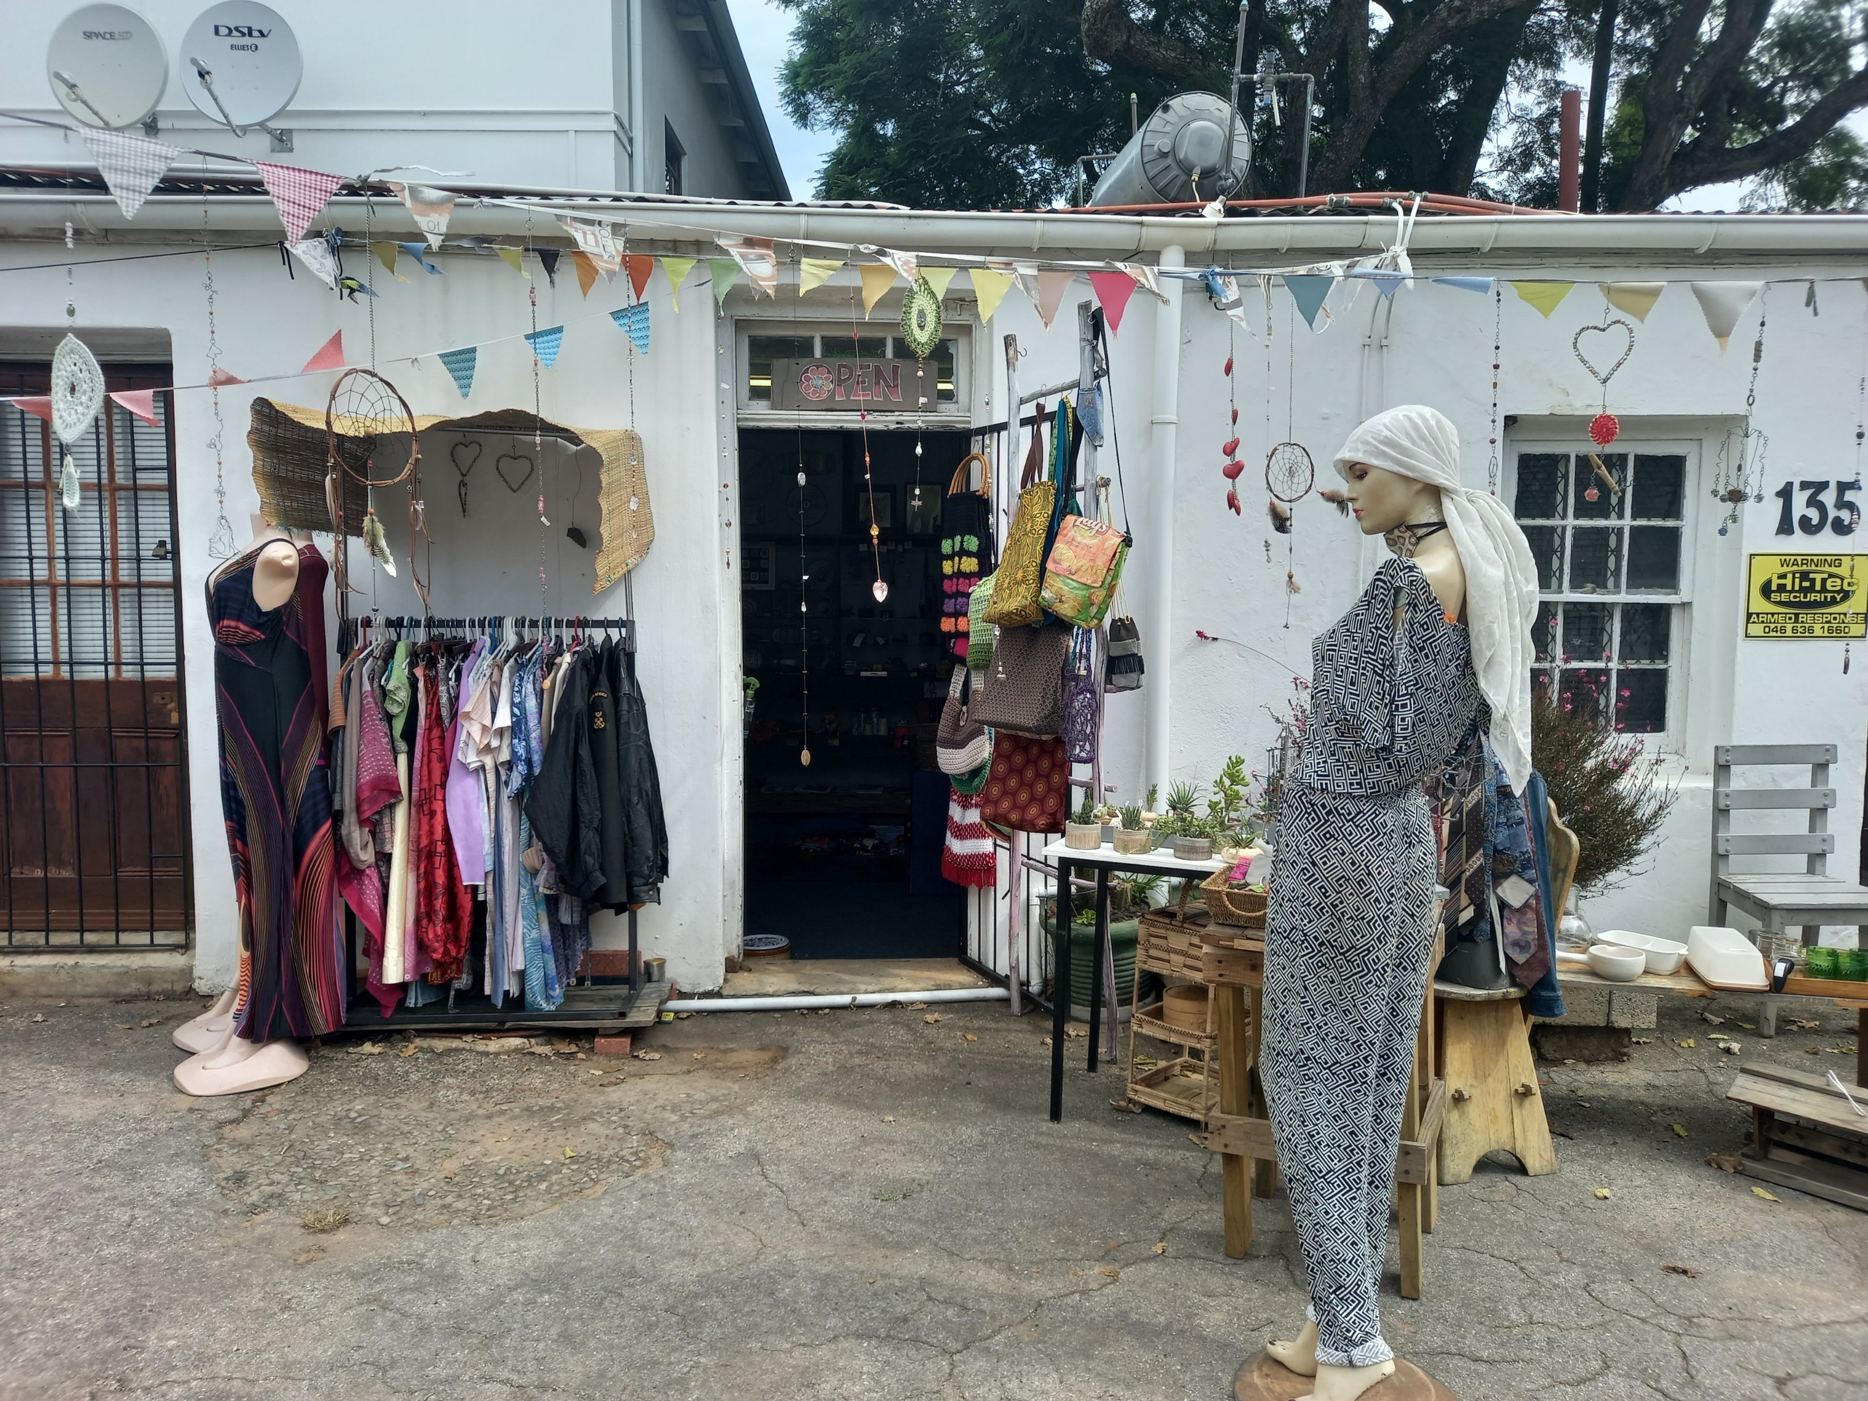
Under the arch

Slide 7
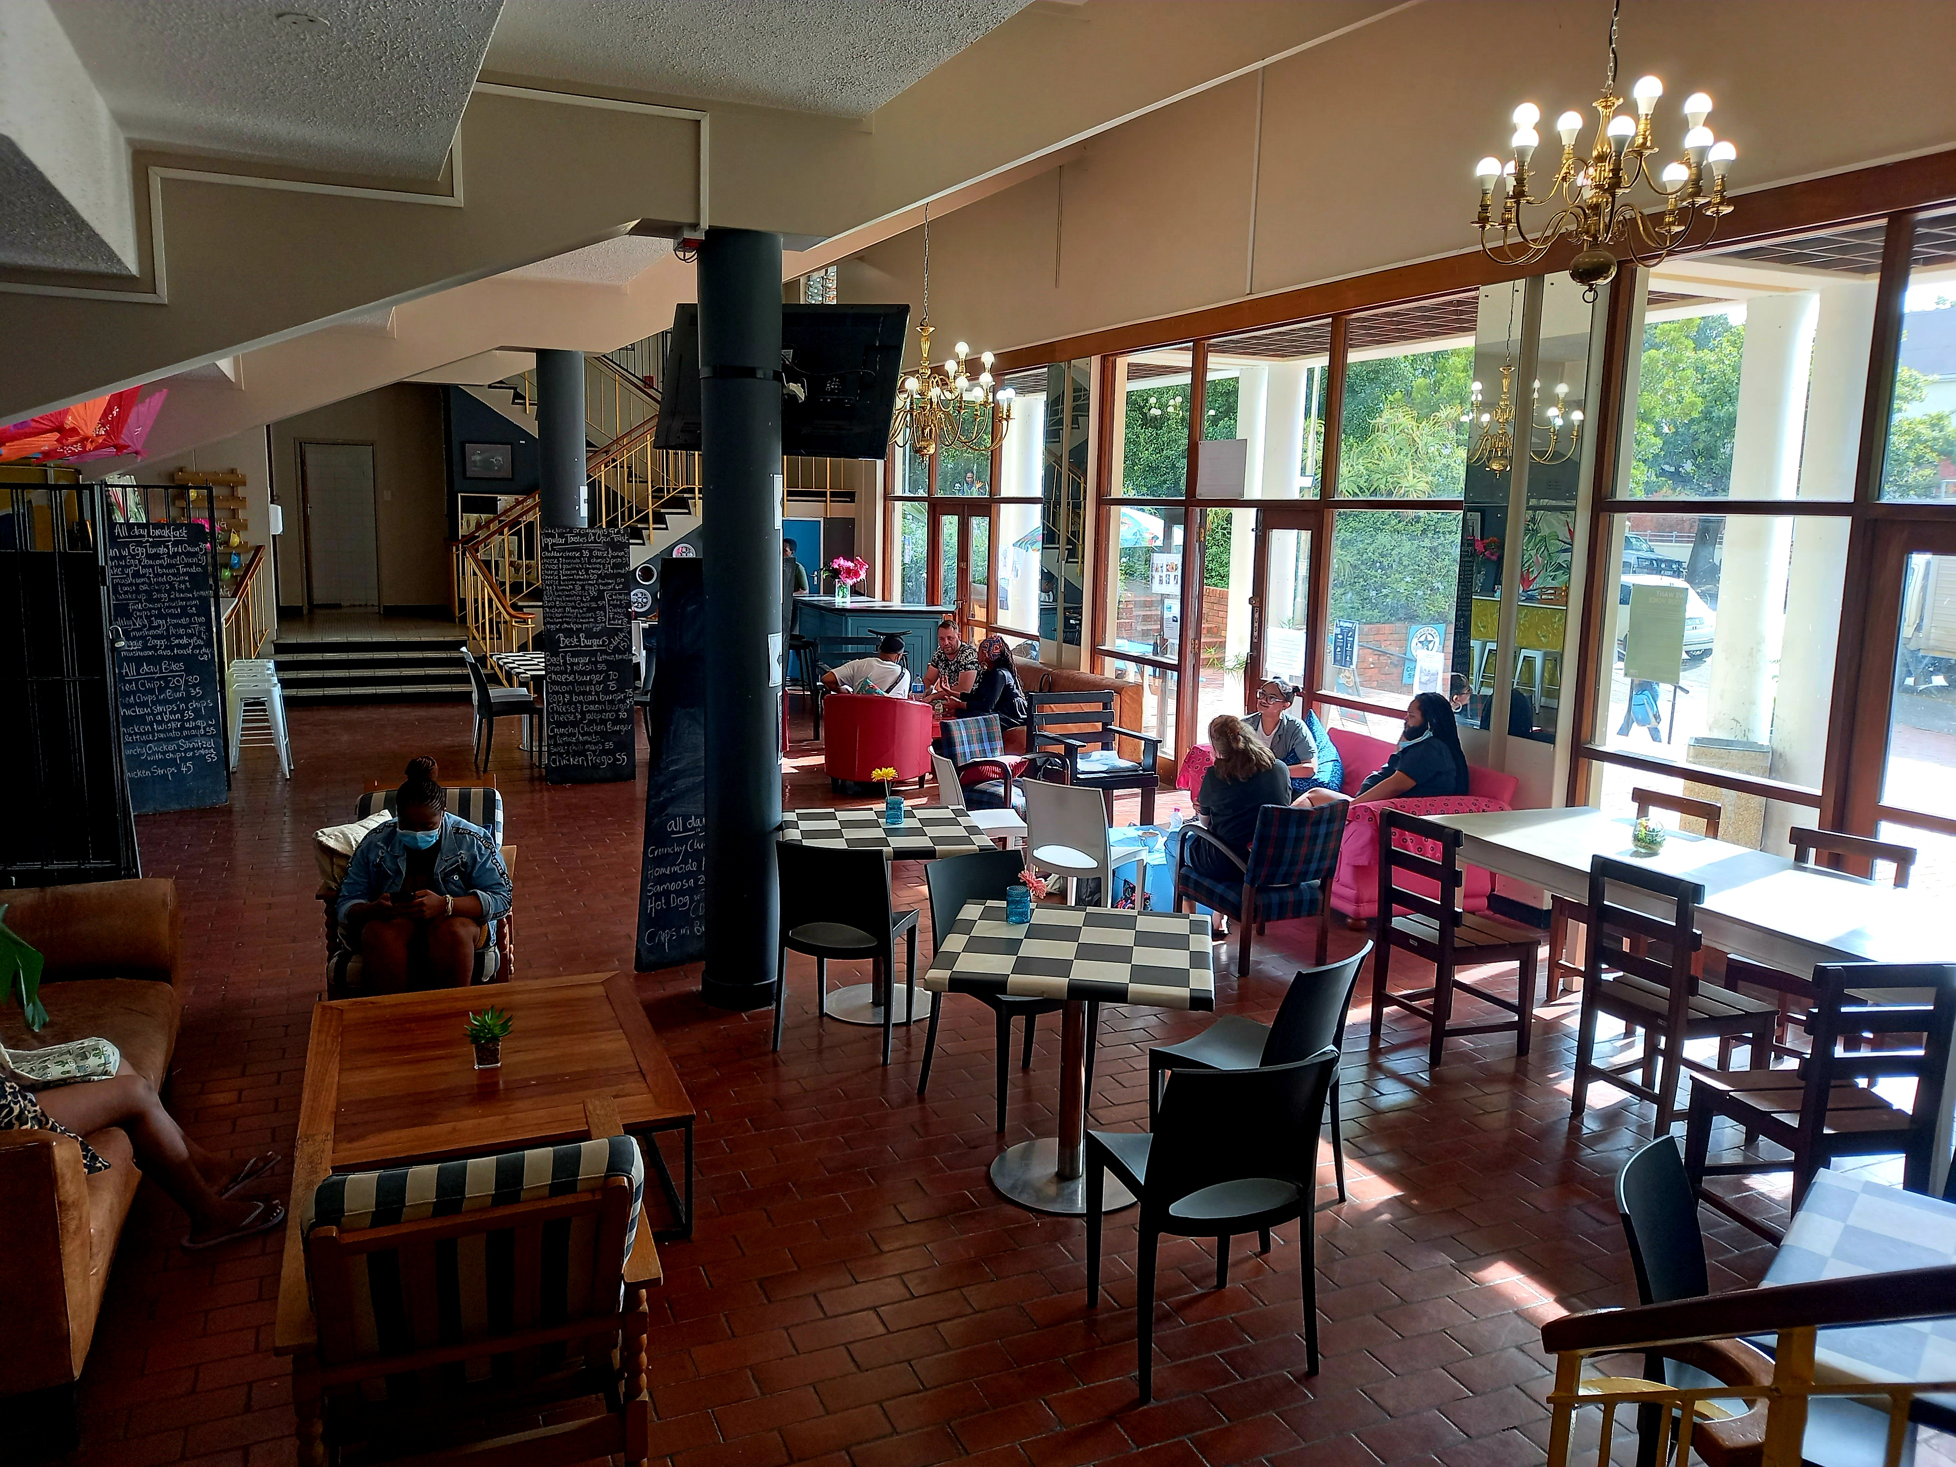
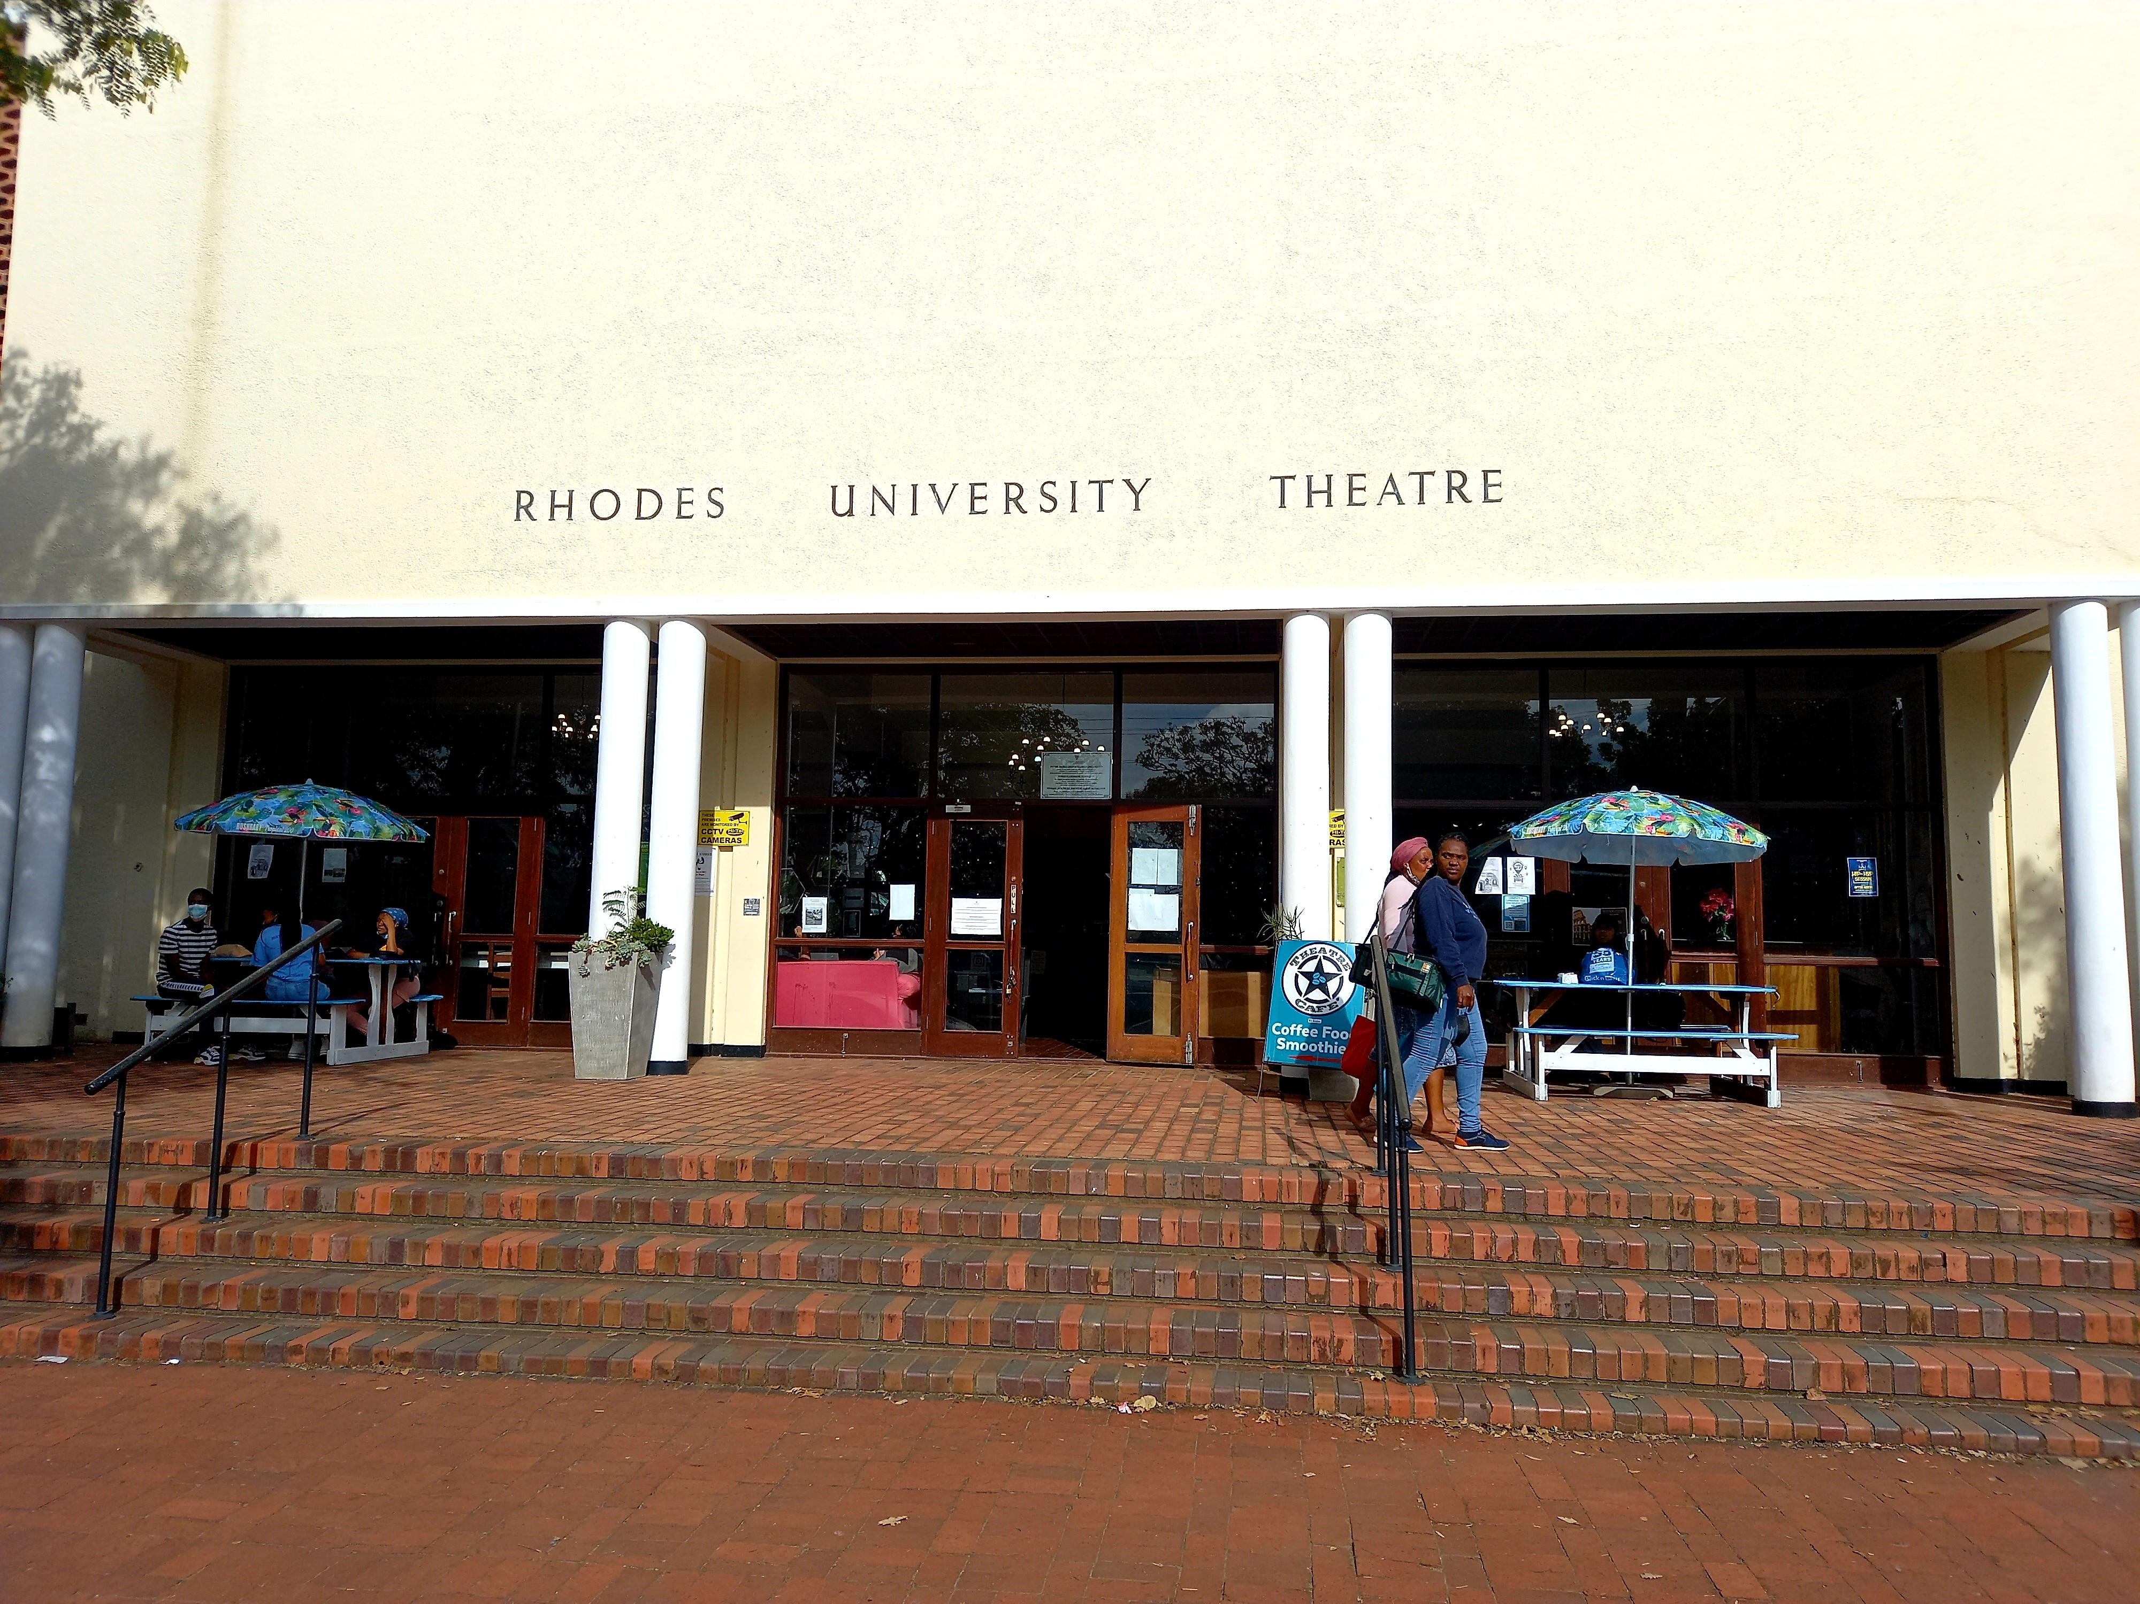
Theatre cafe

